Slide 1
Music Rater – Status for 9/30/2024
Adrianna Bordonaro, Project Manager
adrianna.bordonaro1@marist.edu

Slide 2
Executive Summary
Complete: Email & password account creation & verification, Google login
On schedule: UX/UI design (Figma), logo/colors, landing page
In progress: Spotify login
At risk: N/A
Complete: Google login redirection issue fixed

Slide 3


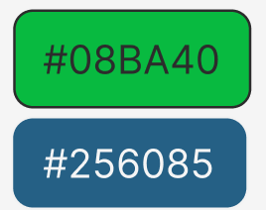
Status Details
Spotify login
302 Callback/URL redirect error
UX/UI
Emulating vs differentiating from Spotify
Dark mode/light mode
Mobile vs desktop
Record logo

Slide 4
Next Steps / Actions
Complete UX/UI design
Complete Spotify login and work on API integration

Slide 5
Thank you
Questions?

